Slide 1
Conditional Expressions and Statements
Dr. Nachiket Tapas

Slide 2
Conditional Expressions
Expressions which evaluate to TRUE or FALSE
Also known as boolean expression
Expression can be combination of individual conditions
Ex: 3 < 5 || 3 > 15, 100

Slide 3
Operators you can use
Relational operators (>, <, >=, <=, ==, !=)
Logical operators (&&, ||, !)
Bitwise operators (&, |, !)

Slide 4
Conditional Statements
Also known as decision making and branching statements.
C program execution is sequential in nature.
To change the order of execution, conditional statements are used.
Example: If (अगर) it does not rain, then (फिर) we will play cricket. Else (अन्यथा)
, we will play video games.

Slide 5
Types of Conditional/Control Statements
if statement
switch statement
Conditional operator statement (?:) [We know it as Ternaty Operator]
goto statement

Slide 6
IF Statement
Syntax
if( test expression ) {
statement 1;
statement 2;
statement 3;
}
Entry
test expression?
False
True

Slide 7
Types of IF statements
Simple if statements
if … else statements
Nested if … else statements
else if ladder

Slide 8
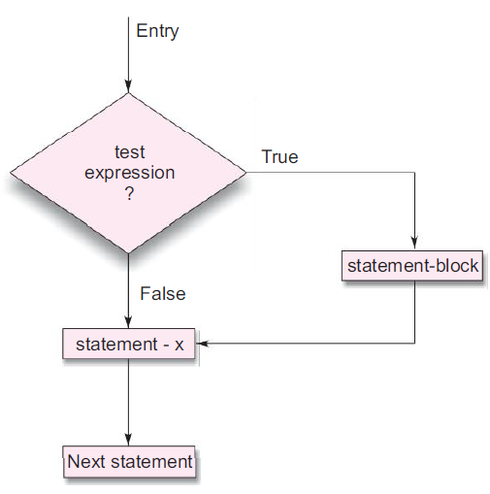
Simple IF Statement
if ( test–expression ) {
statement or block;
}
statement – x;
next statement;

Slide 9
Example
main()
{
int a, b, c, d;
float ratio;
printf(“Enter four integer values\n”);
scanf(“%d %d %d %d”, &a, &b, &c, &d);
if (c-d != 0) /* Execute statement block */
{
ratio = (float)(a+b)/(float)(c-d);
printf(“Ratio = %f\n”, ratio);
}
}
I/P: 10 11 12 13
O/P: -21
I/P: 10 11 12 12
O/P: blank output

Slide 10
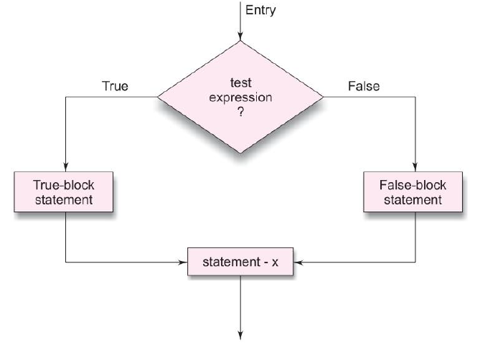
IF … ELSE Statement
if ( test–expression ) {
statement or block (if true);
}
else {
statement or block (otherwise);
}
statement – x;
next statement;

Slide 11
Example
main()
{
int a, b, c, d;
float ratio;
printf(“Enter four integer values\n”);
scanf(“%d %d %d %d”, &a, &b, &c, &d);
if (c-d != 0) /* Execute statement block */
{
ratio = (float)(a+b)/(float)(c-d);
printf(“Ratio = %f\n”, ratio);
}
else
printf(“c – d is zero\n”);
}
I/P: 10 11 12 13
O/P: -21
I/P: 10 11 12 12
O/P: c – d is zero

Slide 12
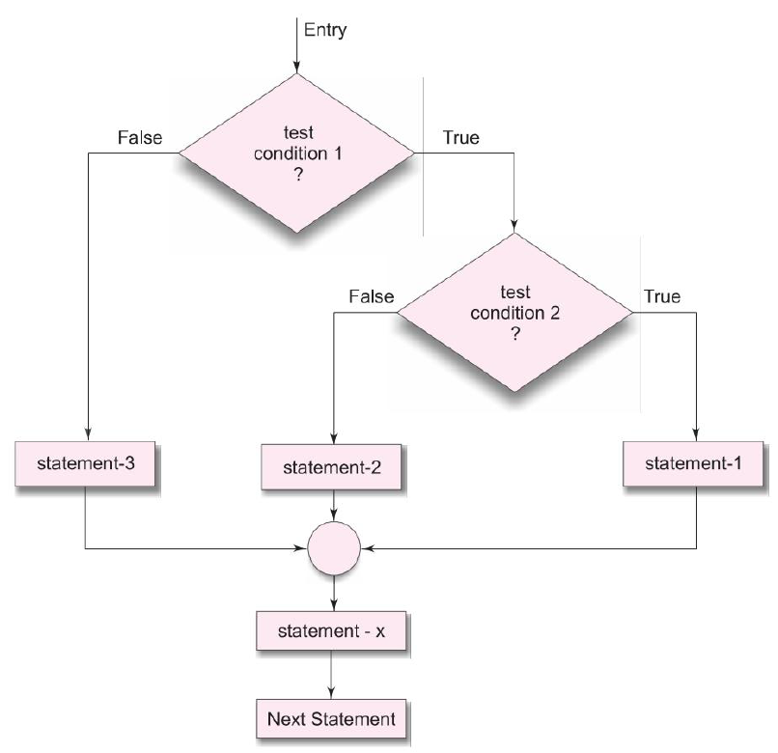
Nested IF - ELSE Statements
if ( test–expression-1 ) { if ( test–expression-2 ) { }
else { } } else { statement or block - 1; } statement – x; next statement;

Slide 13
Example
Enter four integer values
10 11 12 13
Ratio = 1.000000
main()
{
int a, b, c, d;
float ratio;
printf(“Enter four integer values\n”);
scanf(“%d %d %d %d”, &a, &b, &c, &d);
if (c-d != 0) /* Execute statement block */
{ if(a > b) { ratio = (float)(a+b)/(float)(c-d); printf(“Ratio = %f\n”, ratio); } else { ratio = (float)(a-b)/(float)(c-d); printf(“Ratio = %f\n”, ratio); } }
else
printf(“c – d is zero\n”);
}

Slide 14
Example
What does the program do?
main()
{
float A, B, C;
printf(“Enter three values\n”);
scanf(“%f %f %f”, &A, &B, &C);
printf(“\nLargest value is “);
if (A>B)
{
if (A>C)
printf(“%f\n”, A);
else
printf(“%f\n”, C);
}
else
{
if (C>B)
printf(“%f\n”, C);
else
printf(“%f\n”, B);
}
}

Slide 15
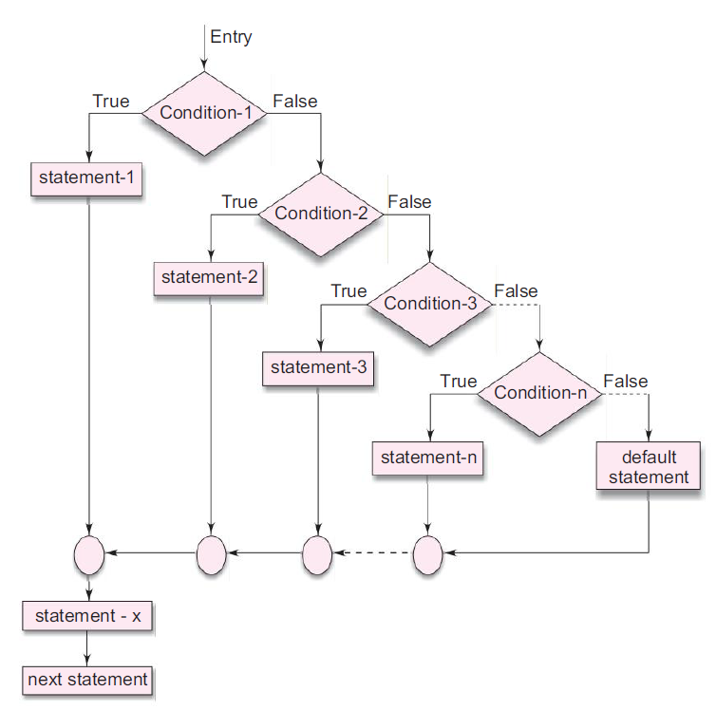
ELSE - IF Ladder
if ( test-expression-1 ) { statement or block - 1; } else if ( test-expression-2) { statement or block - 2; } else if ( test-expression-3) { statement or block - 3; } else if ( test-expression-4) { statement or block - 4; } else {
} statement – x; next statement;

Slide 16
Questions
State true or false
Every line in a C program should end with a semicolon.
In C language, lowercase letters are significant.
Every C program ends with an END word.
main() is where the program begins its execution.
The closing brace of the main( ) in a program is the logical end of the program.
Comments cause the computer to print the text enclosed between /* and */ when executed.

Slide 17
Questions
The __________ Function is used to display the output on the screen.
The escape sequence character __________ causes the cursor to move to the next line on the screen.

Slide 18
What is the output?
/* A simple program
int main( )
{
/* Does nothing */
}

Slide 19
Comma Operator
In C language, the comma operator (represented by the token ,) is a binary operator that evaluates its first operand and discards the result.
Then it evaluates the second operand and returns this value (and type).

Slide 20
Example: Operator VS Separator
#include <stdio.h>
void main() {
int a, b;
int i = (a=2, b=3, a + b);
printf("%d", i);
}

